Slide 1
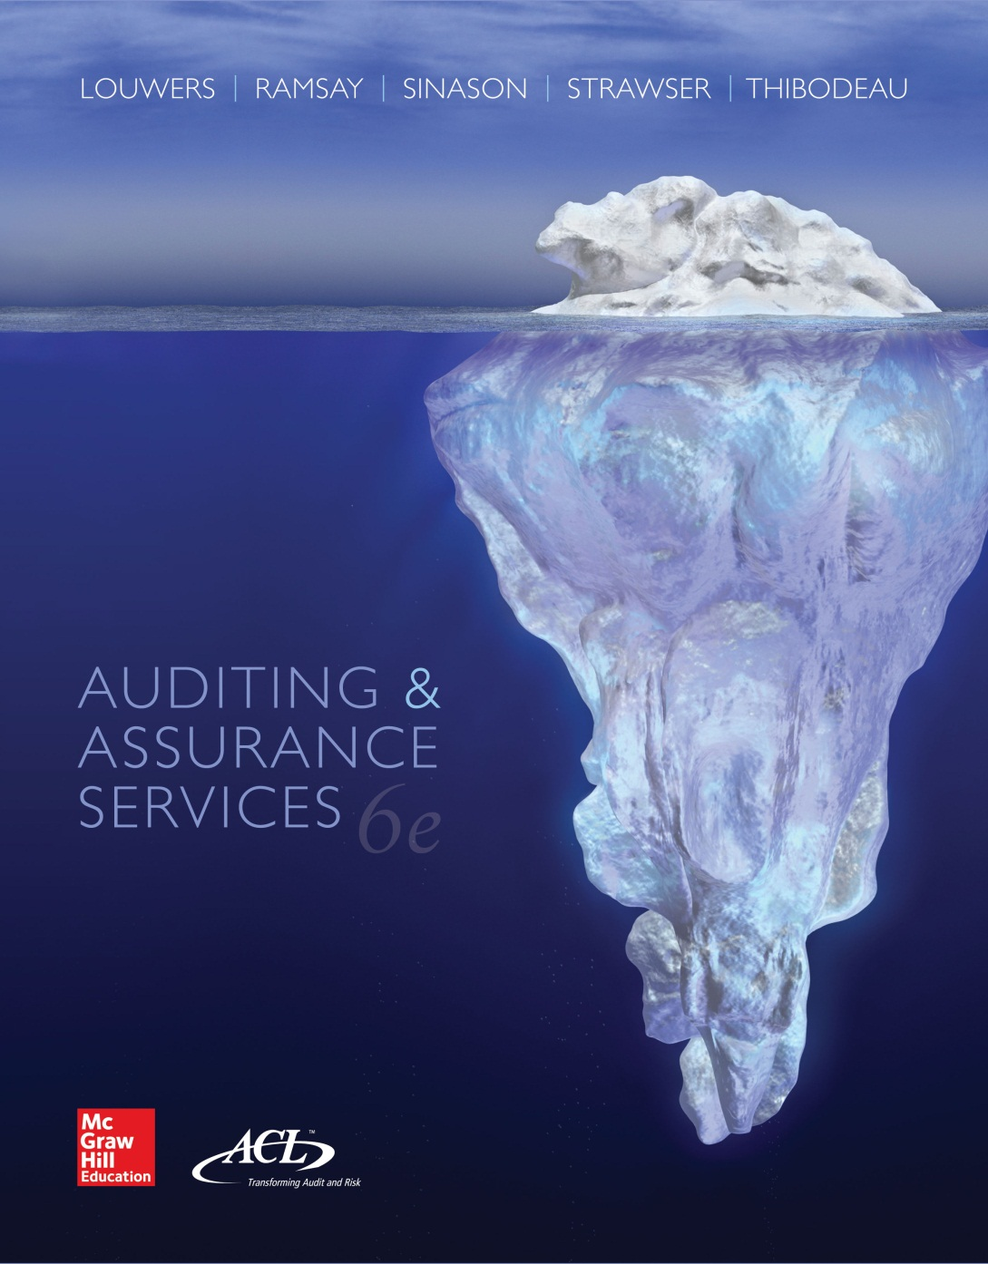
Auditing & Assurance Services, 6e

Slide 2
Chapter 05
Risk Assessment:
Internal Control Evaluation
“Bernie doesn’t want you to use the words “internal controls” in any more of your audit reports…it aggravates him. ”
-- Cynthia Cooper referring to advice given her by a colleague on how to best deal with Bernie Ebbers, the then CEO of WorldCom right before she uncovered an $11 Billion dollar fraud that Ebbers directed.
5-<number>

Slide 3
Learning Objectives
Define and describe internal control and explain the limitations of all internal control systems.
Distinguish between the responsibilities of management and auditors regarding an entity’s internal control.
Define and describe the five basic components of internal control and specify some of their characteristics.
Explain the process the audit team uses to assess control risk, understand its impact on the risk of material misstatement, and, ultimately, to know how it affects the nature, timing, and extent of substantive testing to be performed on the audit.
5-<number>

Slide 4
Learning Objectives (cont.)
Describe additional responsibilities for management and auditors of public companies required by Sarbanes-Oxley and Auditing Standard No. 5.
List the major components of the auditors’ report on internal control over financial reporting.
Describe situations in which the auditors’ report on internal control over financial reporting would be modified.
Explain the communication of internal control deficiencies to those charged with governance such as the audit committee and other key management personnel.
5-<number>

Slide 5
Internal Control Defined
Internal control is a process, effected by an entity’s board of directors, management and other personnel, designed to provide reasonable assurance regarding the achievement of objectives in the following three categories:
    Reliability of financial reporting
    Effectiveness and efficiency of operations
    Compliance with applicable laws and regulations
5-<number>

Slide 6
Limitations of Internal Control
Human error
Collusion
Management override
Cost/benefit analysis
  There is often a trade-off between the cost and the effectiveness of internal controls.
  The concept of reasonable assurance recognizes that the cost of an entity’s internal control should not exceed the benefits that are expected to be derived.
5-<number>

Slide 7
Responsibility for Internal Control
Management’s responsibility
  Responsibility for establishing and maintaining adequate internal control over financial reporting
  Assess and report on the effectiveness of internal control over financial reporting
Auditors’ responsibility
  For public companies, must audit and issue an opinion about the effectiveness of the internal control over financial reporting
  For each fraud risk, must evaluate whether controls are in place to mitigate the fraud risk
  Must assess control risk to determine the nature, timing and extent of substantive procedures to be performed
5-<number>

Slide 8
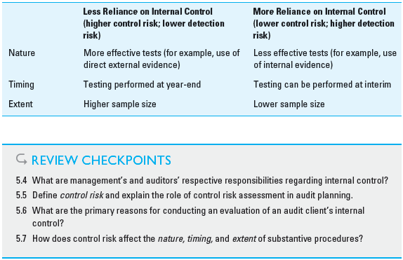
Exhibit 5.2 - Relationship Between Internal Control Reliance and Audit Procedures
5-<number>

Slide 9
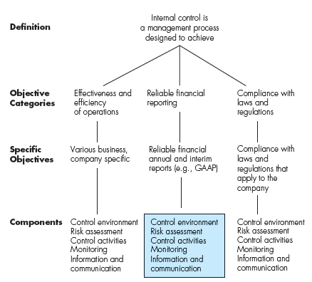
Exhibit 5.3
Internal Control—Integrated Framework (COSO)
5-<number>

Slide 10
COSO
Committee of Sponsoring Organizations of the National Commission of Fraudulent Financial Reporting (Treadway Commission)
Includes the FEI, AAA, IIA, IMA, AICPA
www.coso.org
5-<number>

Slide 11
Internal Control Components (COSO)
Control Environment
Risk Assessment
Control Activities
Monitoring
Information and Communication
5-<number>

Slide 12
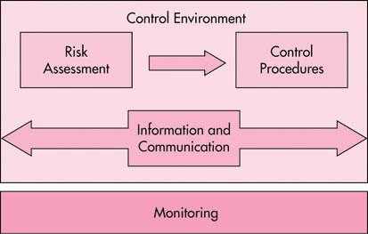
Exhibit 5.4
Interrelated Components of Internal Control
5-<number>

Slide 13
Control Environment
Sets the “tone at the top” of an organization, influencing the control consciousness of its people.
It is the foundation for all other components.
As a result, an auditor must obtain a detailed understanding of the control environment and document that understanding.
5-<number>

Slide 14
Control Environment—General Principles
Integrity and ethical values
Board of directors
Management’s philosophy and operating style
Organizational Structure
Financial reporting competencies
Authority and responsibility
Human resources
5-<number>

Slide 15
Audit Committee
3-6 “outside” members of Board.
Provides a buffer between the audit team and operating management.
Members must be “financially literate.”
One “financial expert”
5-<number>

Slide 16
Audit Committee Duties
Appointment, compensation, and oversight of the public accounting firm conducting the entity’s audit.
Resolution of disagreements between management and the audit team.
Oversight of the entity’s internal audit function.
Approval of nonaudit services provided by the public accounting firm performing the audit engagement.
5-<number>

Slide 17
Risk Assessment
Management’s identification and analysis of relevant risks to achievement of its objectives.
Quite possibly using COSO's Enterprise risk management (ERM) framework
5-<number>

Slide 18
Enterprise Risk Management
Management tool
Provides framework for risk management
Auditors focus on risk of material misstatement
5-<number>

Slide 19
Auditor Focus – Risk Assessment
Should examine management’s process for:
Assessing risks relevant to financial reporting objectives, including fraud risk
Assessing the likelihood and significance of risk of misstatements due to fraud
Deciding about actions to address these risks
5-<number>

Slide 20
Control Activities
The policies and procedures that help ensure management directives are carried out.
  Physical controls over the security of assets
  Separation of duties (SOD)
  Information Processing
    Approvals and authorization
    Verifications and reconciliations
  Performance reviews
Preventive controls vs. detective controls
5-<number>

Slide 21
Principles of control activities
Information technology
Level of integration with their risk assessment process
Selection and development of control activities
Policies and procedures
5-<number>

Slide 22
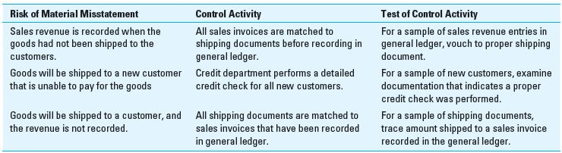
Exhibit 5.5 – Risks, Controls and Testing of Controls
5-<number>

Slide 23
Why Separate Duties??
Combining duties allows a single person to create and conceal errors and frauds.
Segregating duties forces people to commit fraud through collusion—a much harder task!
5-<number>

Slide 24
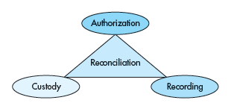
Exhibit 5.6
Separation of Duties
5-<number>

Slide 25
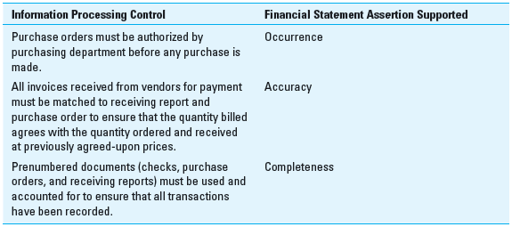
Exhibit 5.7 Information Processing Controls and Financial Statement Assertions
5-<number>

Slide 26
Information and Communication
The identification, capture, and exchange of information in the form that enables people to carry out their responsibilities
Must understand the information systems that are relevant to financial reporting
Information systems produces a trail of activities from data identification to financial reports. This is known as the “audit trail”
5-<number>

Slide 27
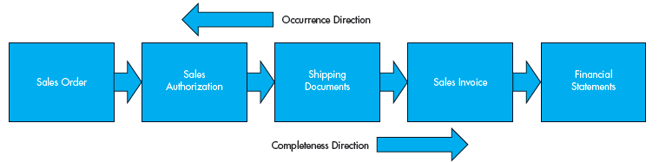
Exhibit 5.8 Occurrence and Completeness of Economic Transactions
5-<number>

Slide 28
Monitoring
Management’s process that assesses the quality of the internal control's performance over time.
  Periodic evaluation by internal auditing
  Supervisory review of controls
  Follow-up of reporting errors
  Follow up of customer complaints
  Audit committee inquiries
5-<number>

Slide 29
Monitoring principles
Ongoing and separate evaluations
Reporting deficiencies
5-<number>

Slide 30
Internal Control Evaluation
Phase 1: Understand and document
  Understand the client’s internal control
  Document the understanding of internal control
    Internal Control questionnaire
    Narrative
    Accounting and control system flowcharts
Phase 2: Assess control risk (Preliminary)
  Consider cost effectiveness of reliance/testing.
Phase 3: Identify Controls to Test and Perform Test of Controls
  Perform test of controls audit procedures
  Re-assess control risk
5-<number>

Slide 31
Why Assess Control Risk?
Determine nature, timing, and extent of audit procedures.
There is a trade-off between testing of controls and substantive procedures.
At least some substantive procedures are required.
Control testing is required for public companies (in accordance with PCOAB AS 5), but remains an auditor judgment for other audits.
5-<number>

Slide 32
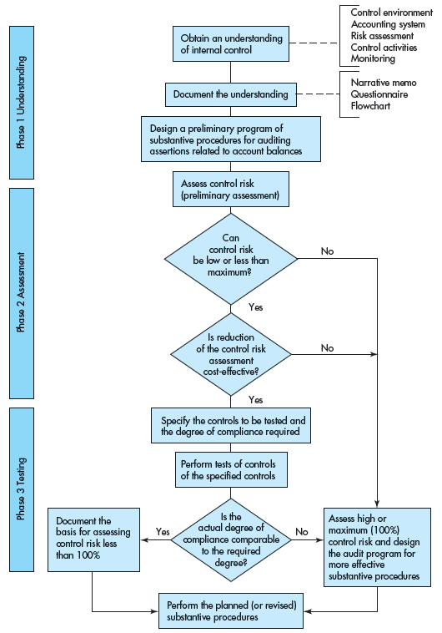
Exhibit 5.9 Phases of Internal Control Evaluation
5-<number>

Slide 33
Documenting Internal Control Understanding
An auditor must document their understanding of internal control on every audit. Can be documented with:
  Questionnaires
  Narratives
  Flowcharts
5-<number>

Slide 34
Should Test of Controls Be Completed?
An auditor may choose not to test controls for one of two reasons:
  Internal control system is too ineffective in preventing or detecting misstatements to rely upon to justify reductions in substantive testing
  It may take more time to test controls than it would to just perform more substantive testing to provide evidence needed to conclude about a financial statement assertion
  For public company audits, an auditor MUST test controls
5-<number>

Slide 35
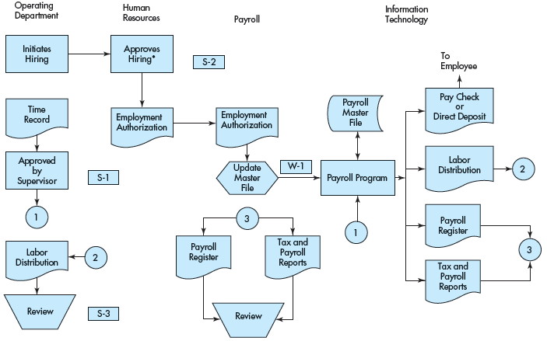
Exhibit 5.12
Payroll System Flowchart
5-<number>

Slide 36
Tests of Controls
After identifying specific control activities that can be relied on to reduce substantive testing for a financial statement assertion, must test the control
Procedures used from the least persuasive to the most persuasive form of evidence:
  Inquiry
  Observation
  Inspection
  Reperformance
Direction of test does matter
5-<number>

Slide 37
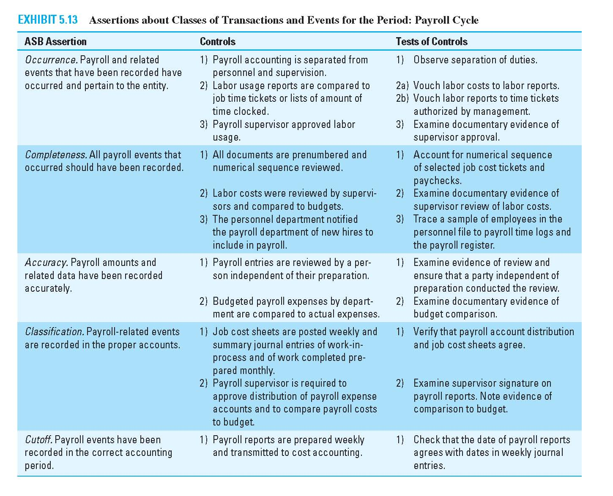
Exhibit 5.13
Assertions about Class Transactions and Events for the Period: Payroll Cycle
5-<number>

Slide 38
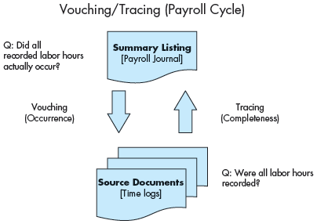
Exhibit 5.14 Dual-Direction Test of Payroll Controls
5-<number>

Slide 39
AS 5: An Audit of Internal Control over Financial Reporting (ICFR) That Is Integrated with an Audit of Financial Statements
Auditors must provide their opinion on the effectiveness of client’s internal control.
Not a separate engagement
  Integrated audit of internal control and financial statements
Public Companies
5-<number>

Slide 40
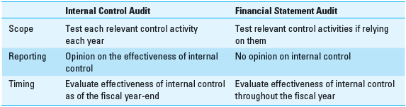
Differences Between AS 5 Internal Control Audits and Financial Statement Audits
5-<number>

Slide 41
AS 5: An Audit of Internal Control over Financial Reporting That Is Integrated with an Audit of Financial Statements (Public Companies)
Phases of the engagement
  Planning the engagement
  Use a top-down approach
      Identify entity-level controls (ELCs)
      Walkthroughs
  Testing controls
      Design effectiveness
      Operating effectiveness
  Evaluating identified deficiencies
      Deficiencies
      Significant deficiencies
      Material weaknesses
  Wrapping up
      Unqualified opinion
      Disclaimer of opinion
      Adverse opinion (Just 1 material weakness!)
  Reporting on internal control
5-<number>

Slide 42
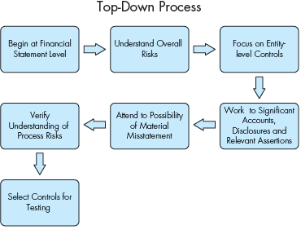
Exhibit 5.15 - Top-Down Process
5-<number>

Slide 43
Step 1: Planning the engagement
Consider knowledge of industry
Consider knowledge of business
Consider extent of changes in operations
Consider extent of changes in internal control
Evaluate controls for all relevant assertions for all significant accounts or disclosures.
5-<number>

Slide 44
Step 2: Using a top-down approach
Identify entity-level controls
Perform walkthroughs
Auditor must perform work related to:
    Company-wide anti-fraud programs
    Controls that have a pervasive effect
Auditor but can incorporate work of internal auditors and others
  Must obtain “principal evidence” for opinion on their own
  Must assess competence and objectivity
  Limited reliance
  Can’t reduce work on control environment
5-<number>

Slide 45
Step 3a: Testing Controls: Design Effectiveness
Design effectiveness determines whether the controls over financial reporting, if operating effectively, would be expected to prevent or detect errors or fraud that could result in a material misstatement in the financial statements.
After an understanding of internal controls is gained through inquiry, inspection, and observation, the controls are evaluated for the possibility that the controls would not prevent or detect a misstatement.
5-<number>

Slide 46
Step 3b: Testing Controls: Operating Effectiveness
Operating effectiveness is whether the control is operating as designed and whether the person performing the control possesses the necessary authority and qualifications to perform the control effectively.
A sample of transactions is examined using inquiry, observation, inspection, and reperformance.
Tests of controls would not be performed if design is not evaluated as effective.
5-<number>

Slide 47
Step 4a: Evaluate identified deficiencies
Whether the result of a design deficiency or an operating deficiency, an internal control deficiency exists when the design or operation of a control does not allow the entity’s management or employees to detect or prevent misstatements in a timely fashion.
  A design deficiency is a problem relating to either a necessary control that is missing or an existing control that is so poorly designed that it fails to satisfy the control’s objective.
  An operating deficiency, on the other hand, occurs when a properly designed control is either ignored or inappropriately applied (possibly because employees are poorly trained).
More serious internal control deficiencies can be categorized into one of two groups, significant deficiencies or material weaknesses, depending on their severity.
5-<number>

Slide 48
Step 4b: Identify significant deficiencies
Significant deficiencies are defined as conditions, or combinations of conditions, that could adversely affect the organization’s ability to initiate, record, process, and report financial data in the financial statements.
While not material, they are important enough to bring to the attention of those charged with governance (usually the audit committee).
  Absence of appropriate separation of duties.
  Absence of appropriate reviews and approvals of transactions.
  Evidence of failure of control procedures.
5-<number>

Slide 49
Step 4c: Identify Material Weaknesses
A material weakness in internal control is defined as a deficiency, or combination of deficiencies, that results in a reasonable possibility that a material misstatement would not be prevented or detected on a timely basis.
Indicators of possible material weakness
  Restatement of previously issued financial statements to reflect the correction of a misstatement.
  Evidence of material misstatements (caught by the audit team) that were not prevented or detected by client’s internal controls.
  Ineffective oversight of financial reporting process by entity’s audit committee.
  Indication of fraud (either material or immaterial) by senior management.
5-<number>

Slide 50
Summary of Internal Control Deficiencies
Three categories
  Internal control deficiency
  Significant deficiency
  Material weaknesses
The difference between a significant deficiency and a material weakness is the (1) likelihood and (2) materiality that a potential (or actual) misstatement would not be detected on a timely basis.
5-<number>

Slide 51
Step 5: Wrapping up
Auditors can issue one of three types of opinions on internal control over financial reporting:
  Unqualified. No (zero) material weaknesses found.
  Disclaimer of opinion. The audit team cannot perform all of the procedures considered necessary.
  Adverse opinion. One or more material weaknesses found.
Evaluate management’s report on the effectiveness of internal control.
5-<number>

Slide 52
Step 6: Reporting on Internal Control
Can be a separate report on internal control
  Opinion on financial statements contained in separate audit report
  Extra paragraph added to report on internal control referencing opinion on financial statements.
Or an integrated audit report and report on internal control and the financial statements
  Includes auditor’s opinions on 1) internal control effectiveness, and 2) the fairness of the company’s financial statements.
5-<number>

Slide 53
Auditor’s Report On Internal Control Over Financial Reporting (ICFR)
Title—include the word independent
Responsibility of auditors and management
In accordance with PCAOB standards
Definition of internal control over ICFR
Inherent limitations
Opinion
Reference to opinion on financial statements
Date of report
5-<number>

Slide 54
Modifications to the Auditors’ Standard Report on Internal Control
Material weaknesses in the entity’s internal control over financial reporting
Effect of an adverse opinion on internal control on the auditor’s opinion on the financial statements
Restriction on the scope of the engagement
5-<number>

Slide 55
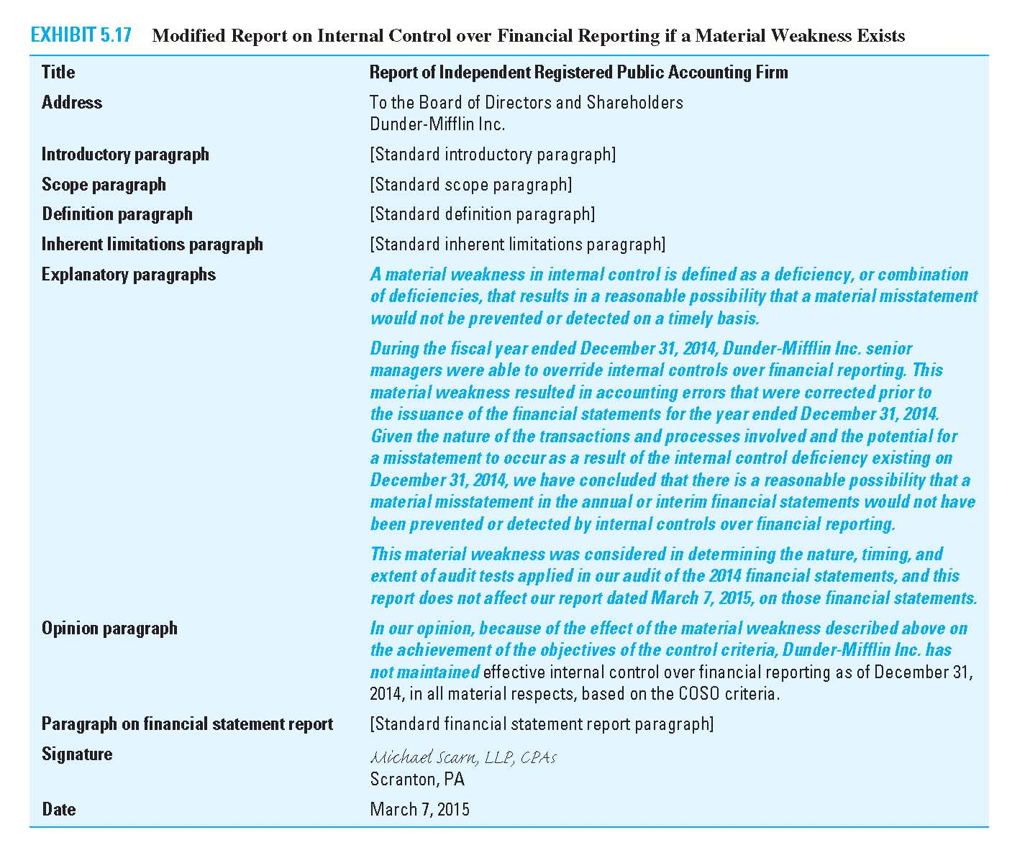
Exhibit 5.17 – Report on Internal Control over Financial Reporting if a Material Weakness Exists
5-<number>

Slide 56
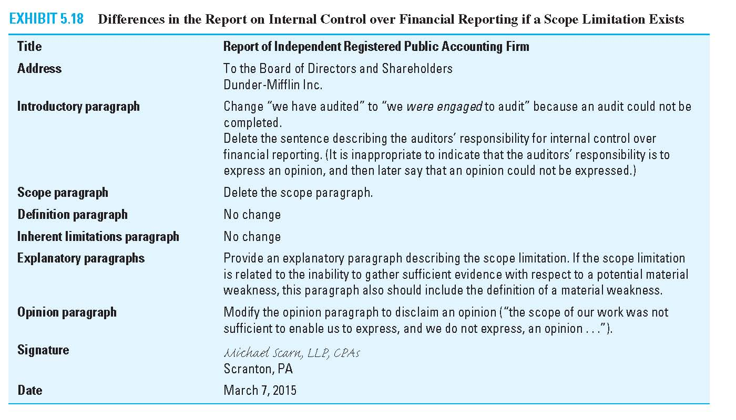
Exhibit 5.18 – Report on Internal Control over Financial Reporting if a Scope Limitation Exists
5-<number>

Slide 57
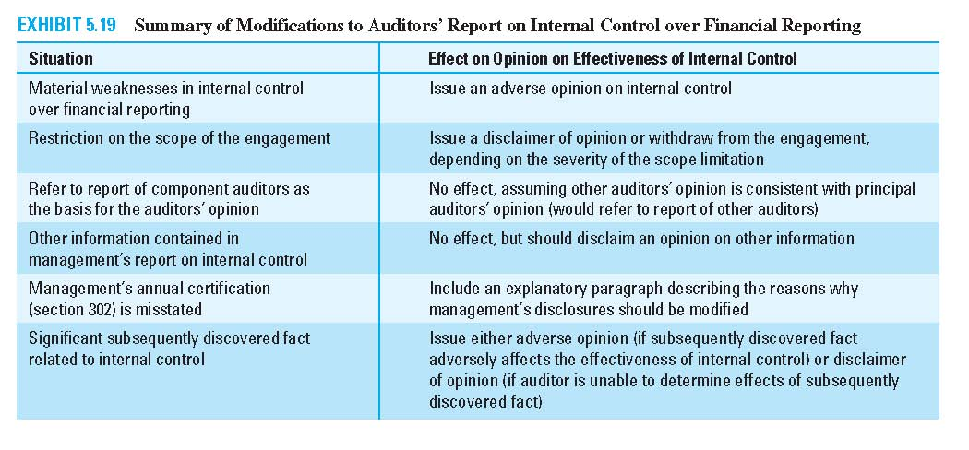
Exhibit 5.19 – Modifications to Auditors’ Report on Internal Control Over Financial Reporting
5-<number>

Slide 58
Reporting to Audit Committee on Internal Control Related Matters
Significant deficiencies and material weaknesses
Sarbanes-Oxley requires that the report be in writing.
The auditor may communicate during or after audit.
5-<number>

Slide 59
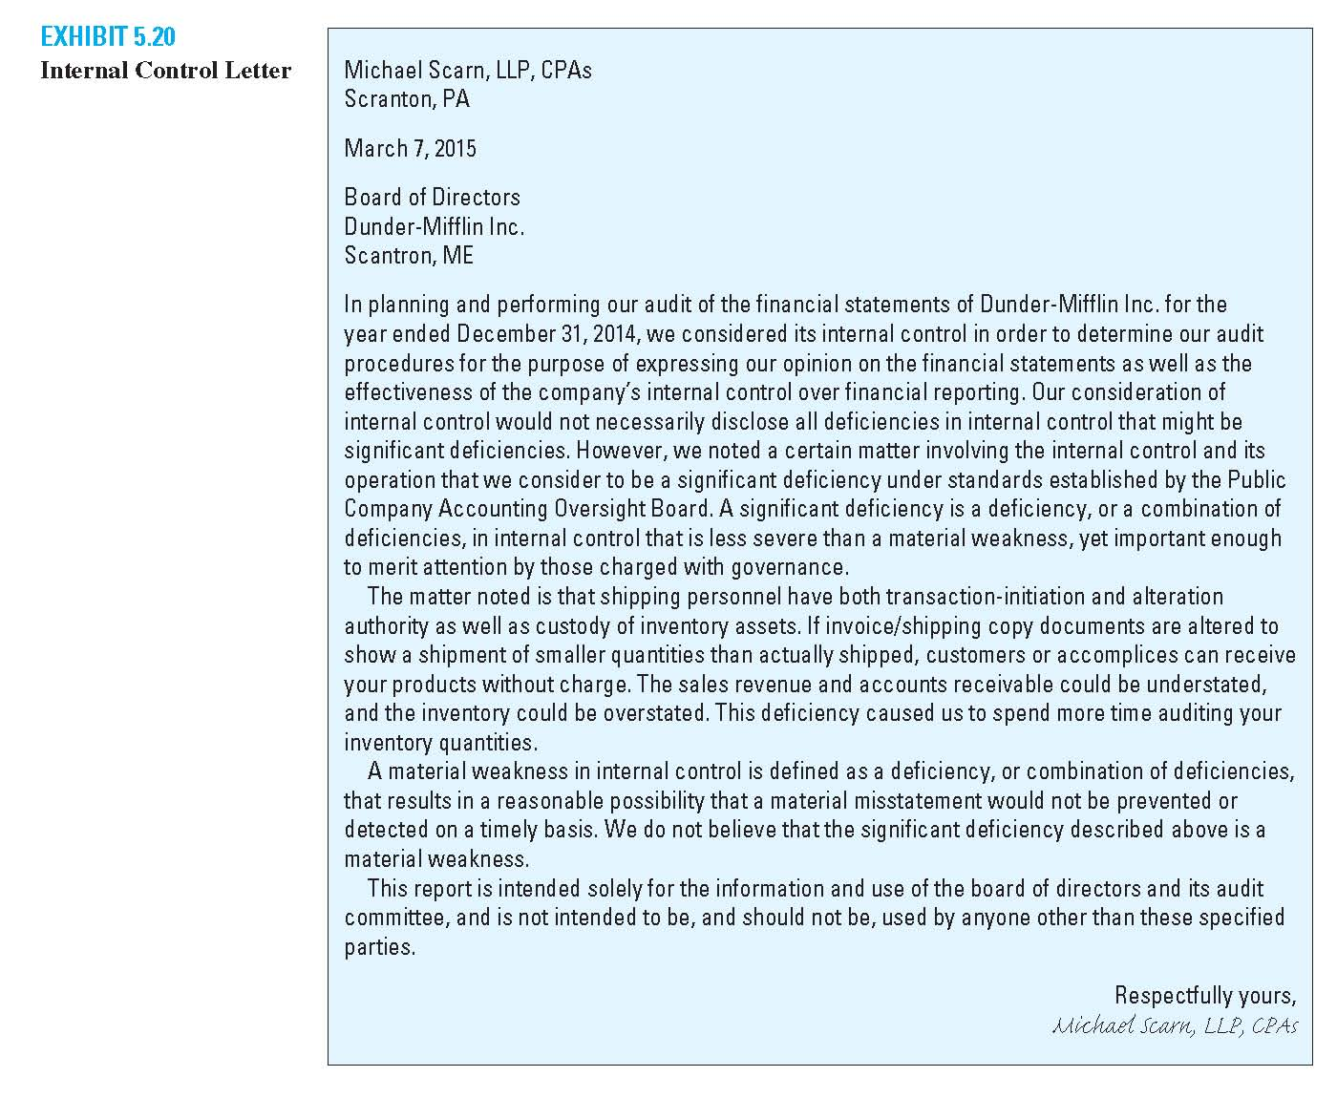
Exhibit 5.20 – Internal Control Letter
5-<number>

